Slide 1
Unveiling the potential of Graph Neural Networks for network modeling and optimization in SDN

Slide 2
Main contributions of the article
Application of Graph Neural Networks (GNN) in networking problem
Estimation of QoS as primary problem
Studied different use-cases when combined with optimizer in KDN
Improvement wrt other techniques
Added generalization also considering changes in topologies and routing without loss of accuracy
Actual implementation of a GNN in networking field: RouteNet, based on MPNN
GNN: https://ieeexplore.ieee.org/stamp/stamp.jsp?tp=&arnumber=4700287&tag=1
Graph networks and why they work well: https://arxiv.org/abs/1806.01261
Message Parsing Neural Networks (MPNN) applied in quantum chemistry: https://arxiv.org/abs/1704.01212

Slide 3
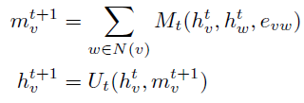
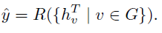
Basics on GNN
Graph-based models bring an improvement when the NN should learn also features related to edges and nodes properties (https://arxiv.org/abs/1806.01261)
Need for Relational inductive bias to learn target wrt graph structure
In networking problem, solves the issue of lack of generalization when topologies and routing schemes change (all state-of-art solutions lack on these)
State of the art solutions in GNN (library: https://github.com/deepmind/graph_nets)
MPNN
Non-local Neural Networks
MPNN
Message Passing (T steps) -> learning phase of the graph structure (hidden vector of both nodes and edges)
Readout -> utilization of the previously learned graph structure, in order to learn the readout function R, that is the one to be estimated:
 | Messages (message function) M to compute relationship between edges and nodes and viceversa Update function U to update the hidden vectors The most complex configuration involves learning of message function and update function for both edges and nodes

Slide 4
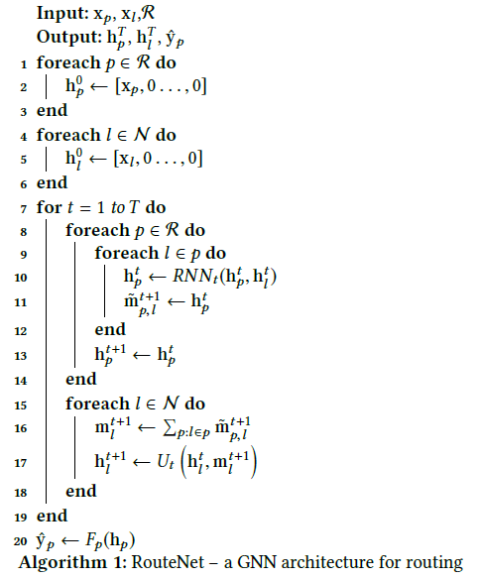
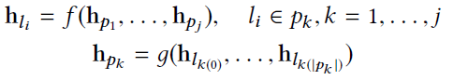
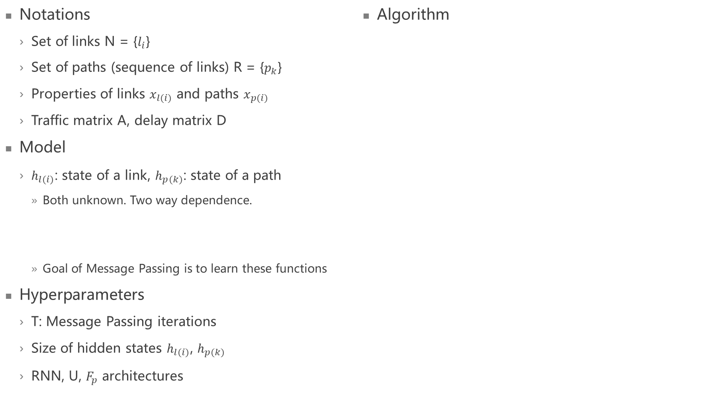
RouteNet (01/2019)
Notations
Set of links N = {$l_{i}$}
Set of paths (sequence of links) R = {$p_{k}$}
Properties of links $x_{l(i)}$ and paths $x_{p(i)}$
Traffic matrix A, delay matrix D
Model
$h_{l(i)}$: state of a link, $h_{p(k)}$: state of a path
Both unknown. Two way dependence.
Goal of Message Passing is to learn these functions
Hyperparameters
T: Message Passing iterations
Size of hidden states $h_{l(i)}$, $h_{p(k)}$
RNN, U, $F_{p}$ architectures
Algorithm

Slide 5
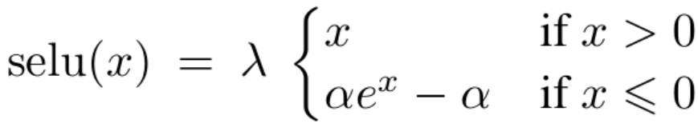
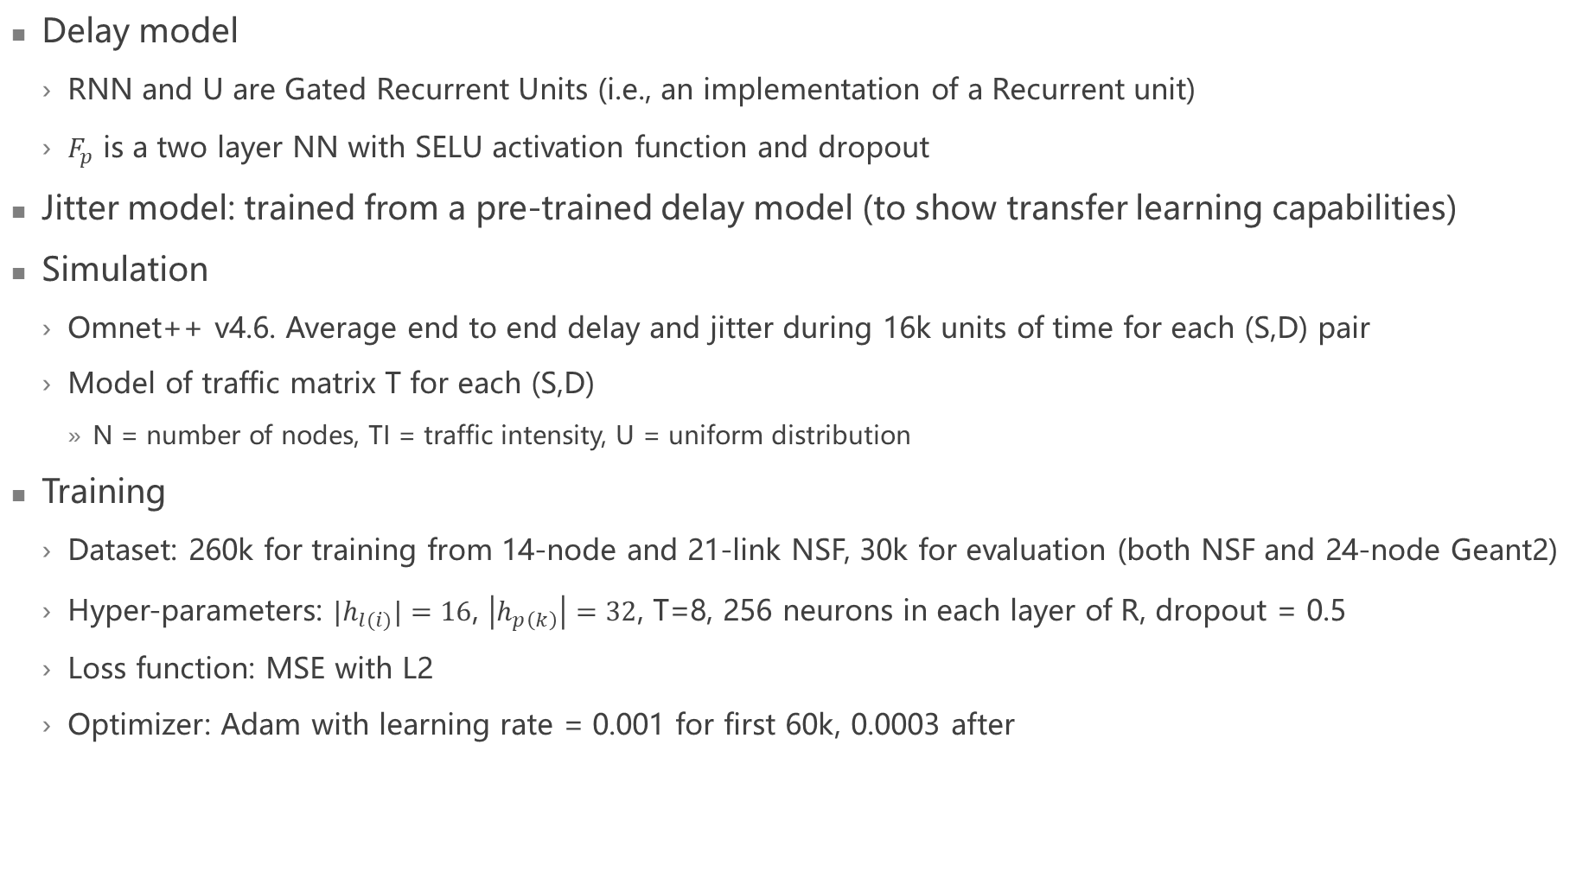
Model and simulation
Delay model
RNN and U are Gated Recurrent Units (i.e., an implementation of a Recurrent unit)
$F_{p}$ is a two layer NN with SELU activation function and dropout
Jitter model: trained from a pre-trained delay model (to show transfer learning capabilities)
Simulation
Omnet++ v4.6. Average end to end delay and jitter during 16k units of time for each (S,D) pair
Model of traffic matrix T for each (S,D)
N = number of nodes, TI = traffic intensity, U = uniform distribution
Training
Dataset: 260k for training from 14-node and 21-link NSF, 30k for evaluation (both NSF and 24-node Geant2)
Hyper-parameters: ${|h}_{l(i)}|=16$, $\left|h_{p\left(k\right)}\right|=32$, T=8, 256 neurons in each layer of R, dropout = 0.5
Loss function: MSE with L2
Optimizer: Adam with learning rate = 0.001 for first 60k, 0.0003 after

Slide 6
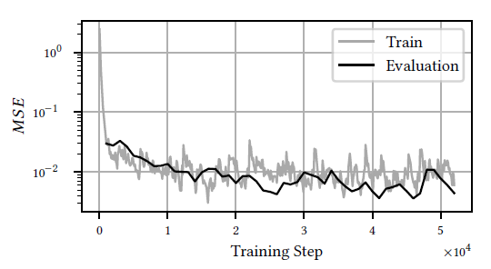
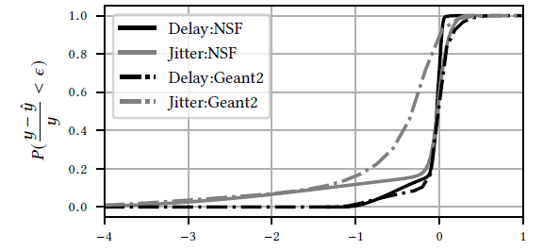
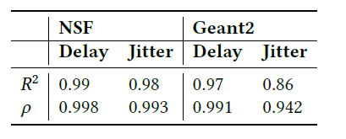
Results and use-cases
Error (jitter for transferable learning)
Evaluation (high level of generalization)
Use – cases (delay and jitter of both max and average value) -> high improvement
Routing optimization
SLA optimization
Robustness against links failures
What-if scenarios (new user, budget constrained network upgrade)

Slide 7
Conclusions
GNN is a strong tool when considering graph settings as network topologies
GNN outperforms other DL techniques in generalization when considering network topologies not seen during training
No other techniques has been studied for QoS estimation with GNNs. Only one considers shortest path routing problem

Slide 8
Strengths and falls
Strenghts
Falls
Ability to generalize also topologies and routing protocols aspects
High performance
Strong tool for networking
Requires also properties of links and paths for learning
Not a great explanation on
learning using the traffic matrix
Nodes and edges in MPNN
Whether the R invariance requirement is satisfied

Slide 9
Improvements
GNN seems to be a great tool for QoS estimation. A further analysis on other techniques could be done (eg: Non local neural networks)
Try generalization result also in use cases techniques
Try other techniques to approximate U, RNN, Fp

